Slide 1
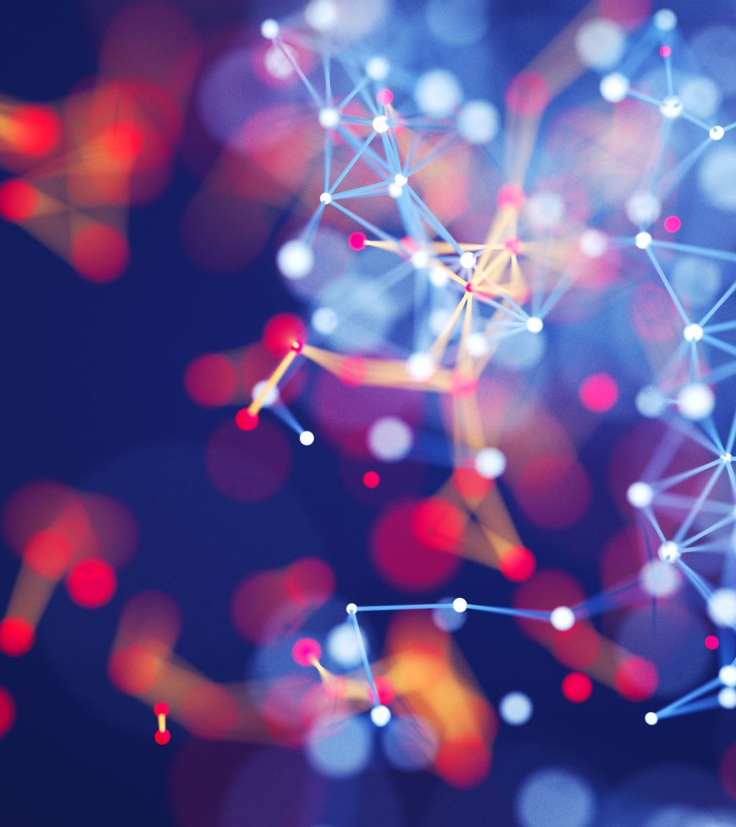
EYES AND AIs
How can Google’s AI predict your gender through your eyes?

Slide 2
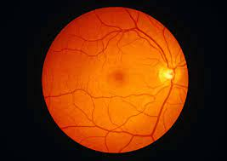
WAIT, GOOGLE CAN DO WHAT?
KEY POINTS:
The google AI can predict someone’s gender based on a retinal scan with a 97% accuracy
Human ophthalmologists can only take a guess, and there is a 50:50 chance of getting it right or wrong
It is done by using a deep learning technique called soft-attention
Notes:
Yes, google can actually guess your gender with an accuracy higher than 97% JUST by looking at your retinal scan. This is something that even experienced ophthalmologists can’t do. In fact, before this discovery, we had no idea that there was any difference whatsoever between the male and female retina, and even after knowing, the doctors can’t understand the differences.
Google’s AI is able to do this using a deep learning technique called ‘soft-attention’

Slide 3
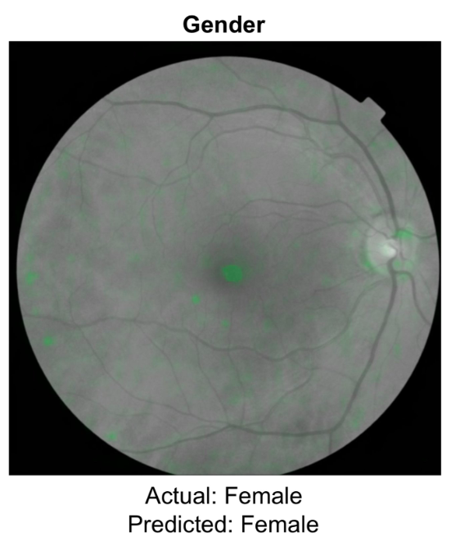
WHAT IS SOFT-ATTENTION?
A deep learning technique used to let the model decide which are the most important features to predict an outcome and focus on them
See in green: areas the model uses to predict gender
Notes:
Soft attention uses the information from previous inputs to decidí which are the features it should pay more attention to, and decides on it’s own how much weight it assigns to each part of the image to predict the best outcome. If you look at the imatge, you can see the parts the model is looking at to predict the gender of the person this scan belongs to.

Slide 4
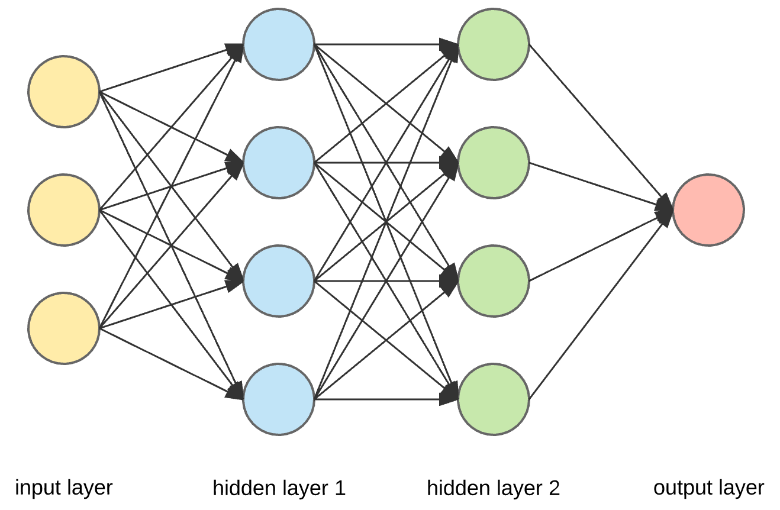
BUT HOW DOES IT WORK?
Standard Neural Network
Notes:
How does soft-attention work?
Well, soft attention is basically the result of years of evolution and bettering this simple Standard neural network, like the ones we have seen in class.
In this example, information gets imputed, the model decides internally and gives an output.
The problem with this kind of network is that it can’t learn from past inputs, to make the same turns as previous inputs, so then the Recurrent Neural Network came into place.

Slide 5
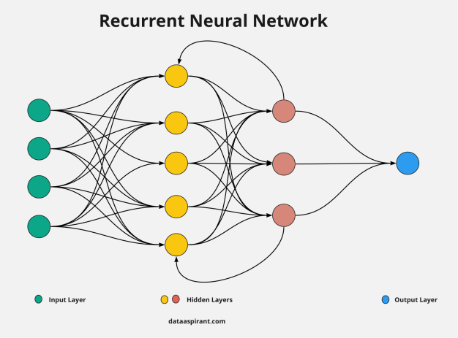
Recurrent Neural Network (RNN)
It loops through the whole network to learn from previous inputs, and is able to relate to them
Notes:
In this network, the whole model is basically inside a loop, so it can learn from the other times the same data has been imputed and give much better results. This is used in language translators and NLP in general.

Slide 6
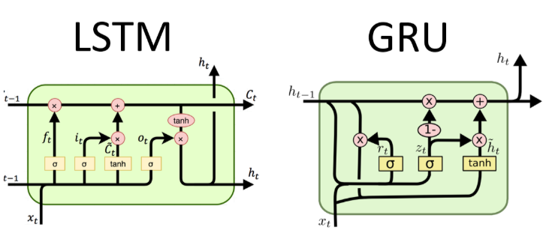
Long Short Term Memory Neural Networks (LSTM) and Gated Recurrent Units (GRU)
Step forward in RNN
Can remember longer relations
Are able to decide when to forget about an input to focus on another
GRU is simple and trains faster, since it “resets” relations directly
LSTM has to forget first, and then create a new one
Notes:
But that also had a problem, and that is that it didn’t perform quite well with older data, so the “long-memory” performance was not the best. It also had trouble learning when it should stop remembering something and start remembering something new, and that is when the LSTM and GRU Recurrent Neural Networks came into place. They can learn to remember inputs from long before, and then they forget about that to remember something else. So kinda like Pokemon, but less cute.

Slide 7
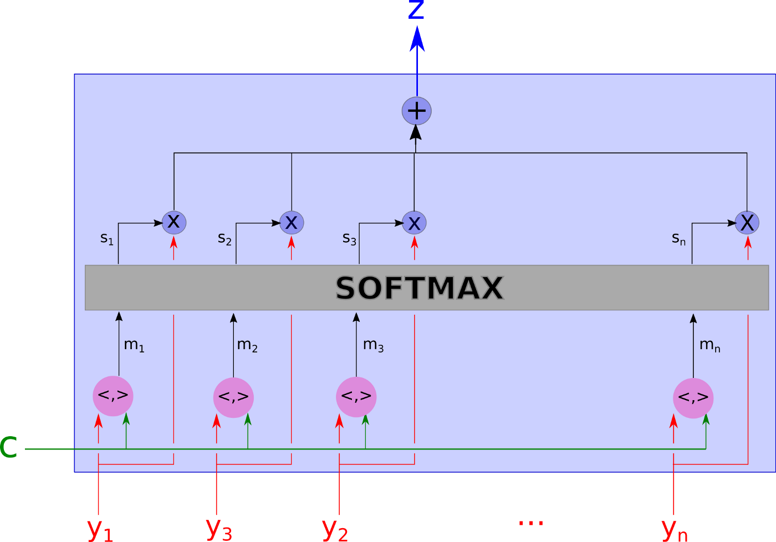
ATTENTION
Parallel processing of inputs instead of processing them sequentially
Only uses parts of the input where the most relevant information is concentrated
The model is able to selectively focus on valuable parts of the input sequence and hence, learn the association between them
Notes:
And finally we come to attention. In this newest advancement of Recurring Neural Networks, this kind of deep learning is able to analyse all the inputs in parallel and for each of them focus only on remembering the most relevant features for each. That is why it is called attention. This has show amazing improvements in deep learning and Neural Networks.

Slide 8
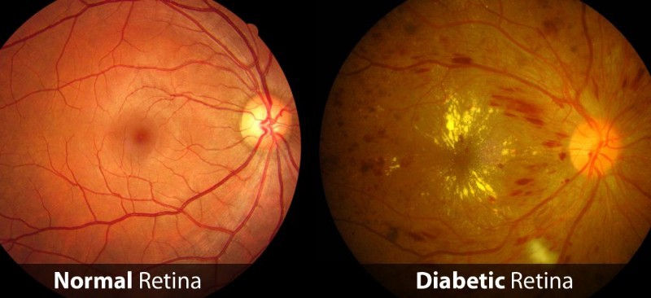
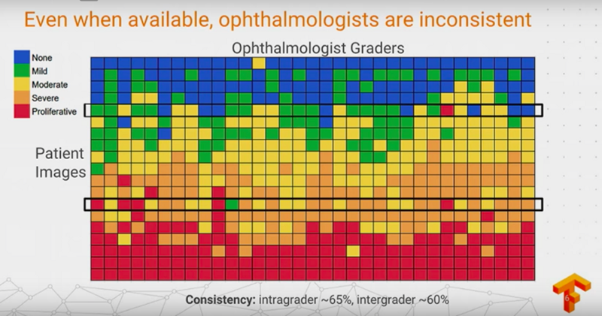
REAL APPLICATIONS: Medicine
Even trained ophthalmologists have inconsistent opinions about the degree and severity of Diabetic Retina
AI has been able to classify and diagnose correctly with an accuracy above 98%
Notes:
But of course, this was not created to determine whether an eye scan belongs to a man or a woman, because why would you? Like there’s literally hundreds of better ways to tell. So, this was a “side-effect” discovered from a medical application, in which the AI was actually trained to detect diabetic retinopathy in the human eye, which is a condition that can actually make you go blind with no way to reverse it if you don’t treat it in time.
One of the biggest problems with this pathology is that not even doctors could agree on how advanced it actually was, or how to classify the different levels of it’s advance.
Google’s AI, on the other hand, is able to do that with a 98% accuracy and is even more consistent.

Slide 9
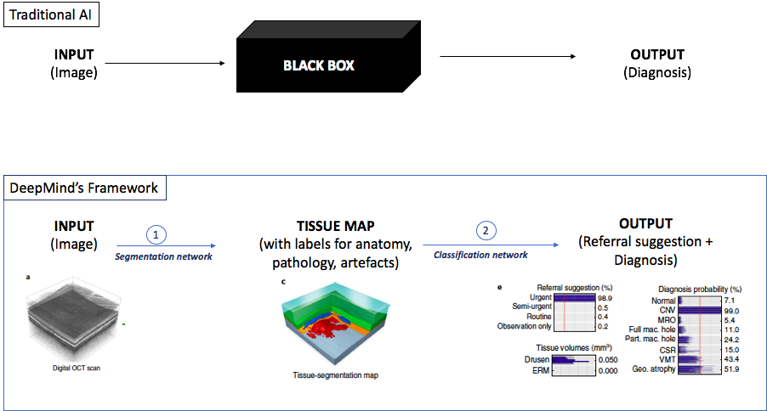
BLACKBOX: MAIN ISSUE IN MEDICINE
The Black Box problem:
Not being able to see deciding criteria that lead to diagnosis
It is highly important to know the reason of a diagnosis in medicine.
Great advances have been made in this area
Notes:
But of course this sounded too nice to be true, and there had to be issues involved. The Black-box problem is something doctors and analysts have been trying to fight for the longest time.
The thing is, when model makes a diagnosis, it is almost impossible to know what that diagnosis is based on, so the “human check” of doctors becomes very difficult.
Lately, though, there have been great advances in this area, throwing different model at the same input, one for determinising the diagnosis, but the other ones to actually predict the features this diagnosis is based upon.
This has allowed lots of diagnosis to be validated by doctors and has supposed a great advance in the field of ophthalmology.

Slide 10

THANK YOU FOR LISTENING
Bibliography & Credits:
Niu, Z., Zhong, G., & Yu, H. (2021). A review on the attention mechanism of deep learning. Neurocomputing, 452, 48–62. https://doi.org/10.1016/j.neucom.2021.03.091
YURTSEVER, M. (2021). Gold Price Forecasting Using LSTM, Bi-LSTM and GRU. European Journal of Science and Technology. https://doi.org/10.31590/ejosat.959405
Madsen, A. (2019). Visualizing memorization in RNNs. Distill, 4(3). https://doi.org/10.23915/distill.00016
Ma, C. (2021). Encoder-Decoder Attention ≠ Word Alignment: Axiomatic Method of Learning Word Alignments for Neural Machine Translation. Journal of Natural Language Processing, 28(2), 694–699. https://doi.org/10.5715/jnlp.28.694
Li, Z., Zhao, D., Li, X., & Zhang, H. (2021). Network security situation prediction based on feature separation and dual attention mechanism. EURASIP Journal on Wireless Communications and Networking, 2021(1). https://doi.org/10.1186/s13638-021-02050-x
Lee, C. S., Yanagihara, R. T., & Lee, A. Y. (2020). Using Deep Learning Models to Characterize Major Retinal Features on Color Fundus Photographs. Ophthalmology, 127(1), 95–96. https://doi.org/10.1016/j.ophtha.2019.07.014
Ratti, E., & Graves, M. (2022). Explainable machine learning practices: opening another black box for reliable medical AI. AI and Ethics. https://doi.org/10.1007/s43681-022-00141-z

Slide 11
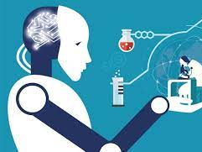
DEBATE QUSTIONS
Would trust an AI over a doctor in predicting an illness?
Would you trust a diagnosis if there is no way of telling which are the decisive parameters?
How can you decide if you want to feed your data to an AI if we don’t know how much it will be able to extract from it?

